Slide 1
Automatic Architectural Trade Studies in SysML

Slide 2
Definition
A trade study or trade-off study is the activity of a multidisciplinary team to identify the most balanced technical solutions among a set of proposed viable solutions
(System Engineering Manual, Federal Aviation Administration, 2006)
A trade study is used to compare with a number of alternative solutions to see whether and how well they satisfy a particular set of criteria. Each solution is characterized by a set of measures of effectiveness (often abbreviated “moe’s”) that corresponds to evaluation criteria and has a calculated value or value distribution. The moe’s for a given solution is then evaluated using an objective function (often called a cost function or utility function), and the results for each alternative are compared to select a preferred solution.

Slide 3
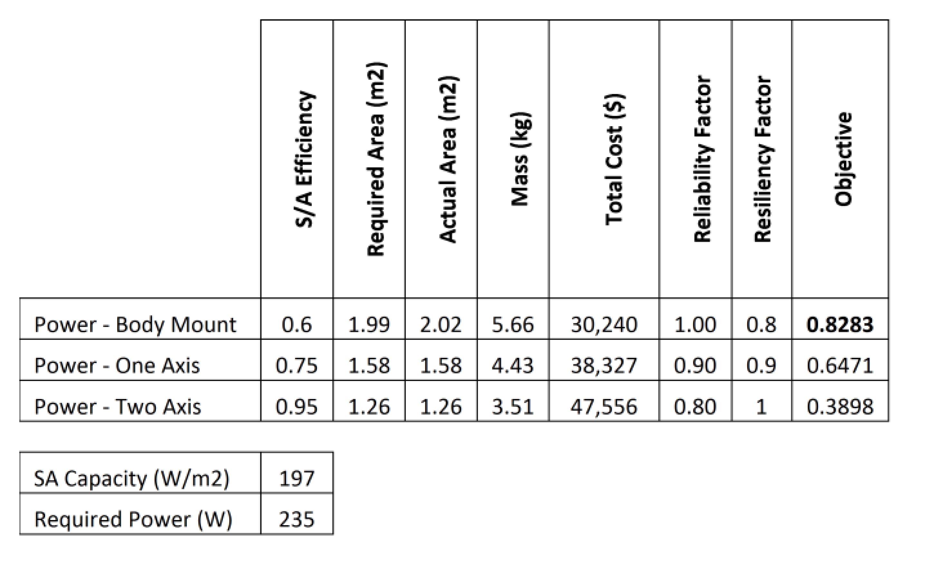

Sample
Sample Trade Studies
Small Sat Constellation vs Large Sat in Geo
Number in constellation vs cost, performance, graceful degradation
Body mounted vs gimbaled solar array

Slide 4
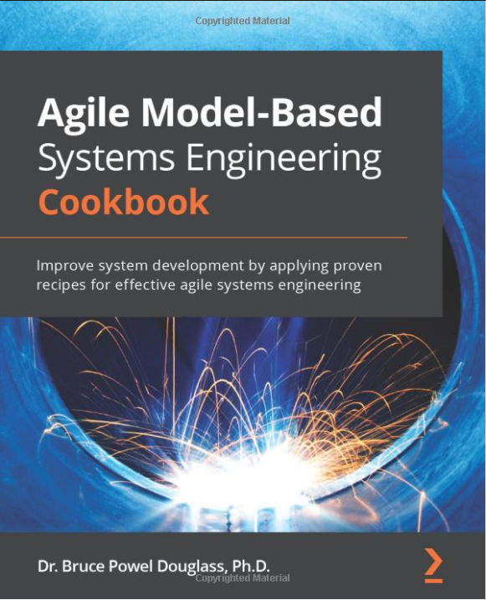
Trade Study Steps
Identify key system functions
Identify candidate solutions
Define assessment criteria
Assign weights to criteria
Define utility curve for each criterion
Assign MoEs to candidate solutions
Perform sensitivity analysis
Determine solution

Slide 5
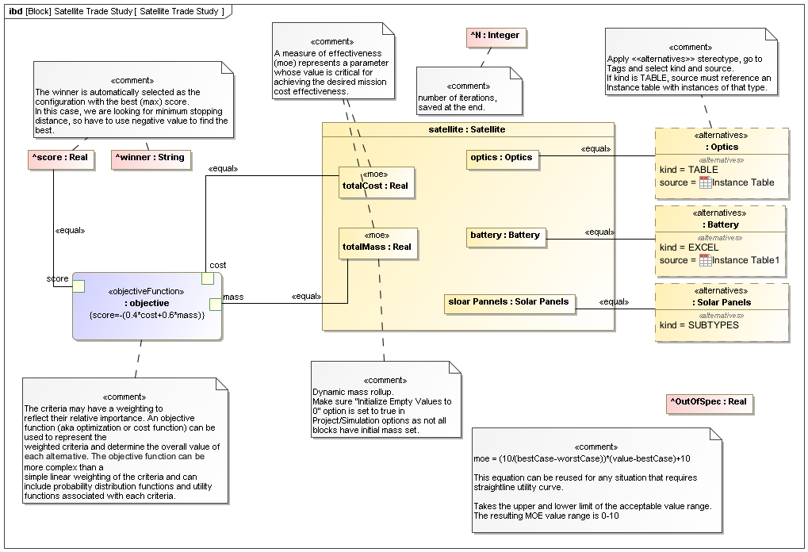
Capability
Simulation Toolkit has built-in support for trade study analysis based on system architecture alternatives. Including:
Alternative identification in Excel, instances, subtypes.
Requirements check and incorrect variants discard.
Automatic variants generation.
Results generation as instance, CSV, etc including number of runs, winner, score, out of spec.

Slide 6
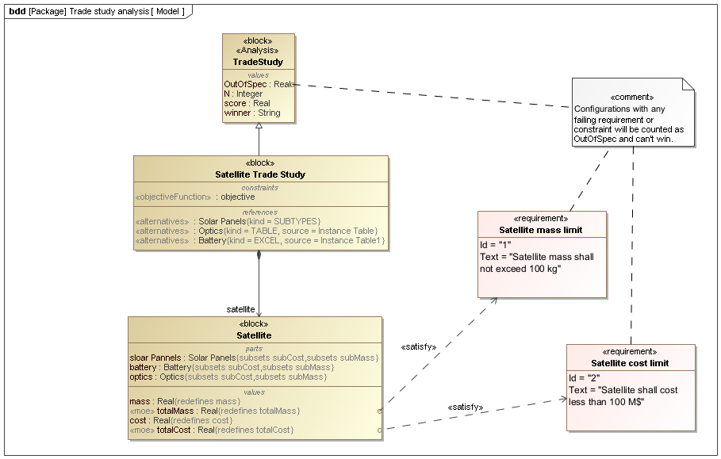
Demo

Slide 7
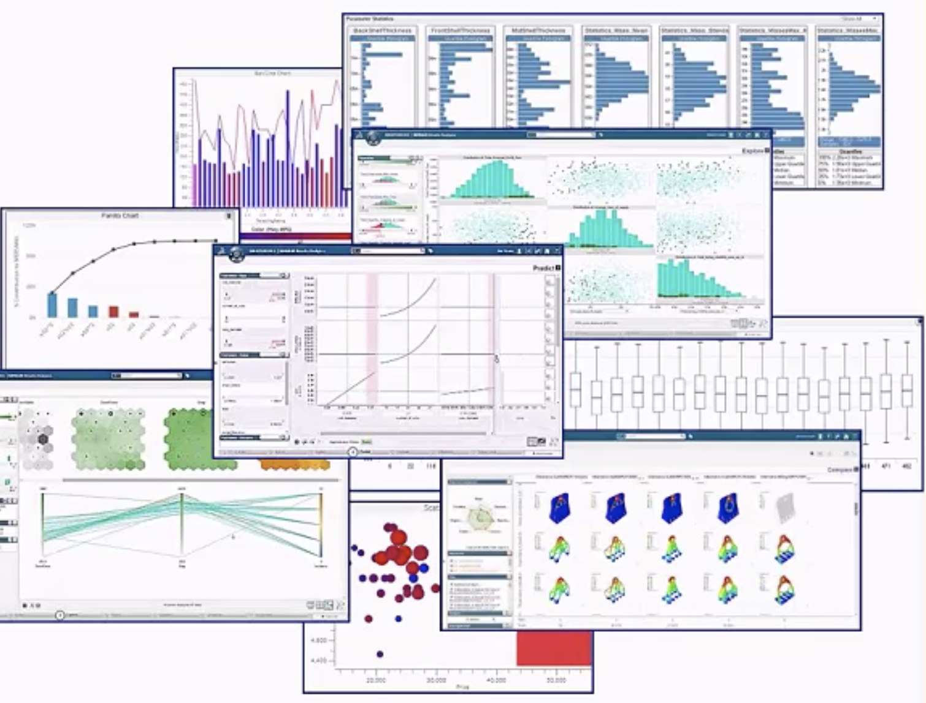
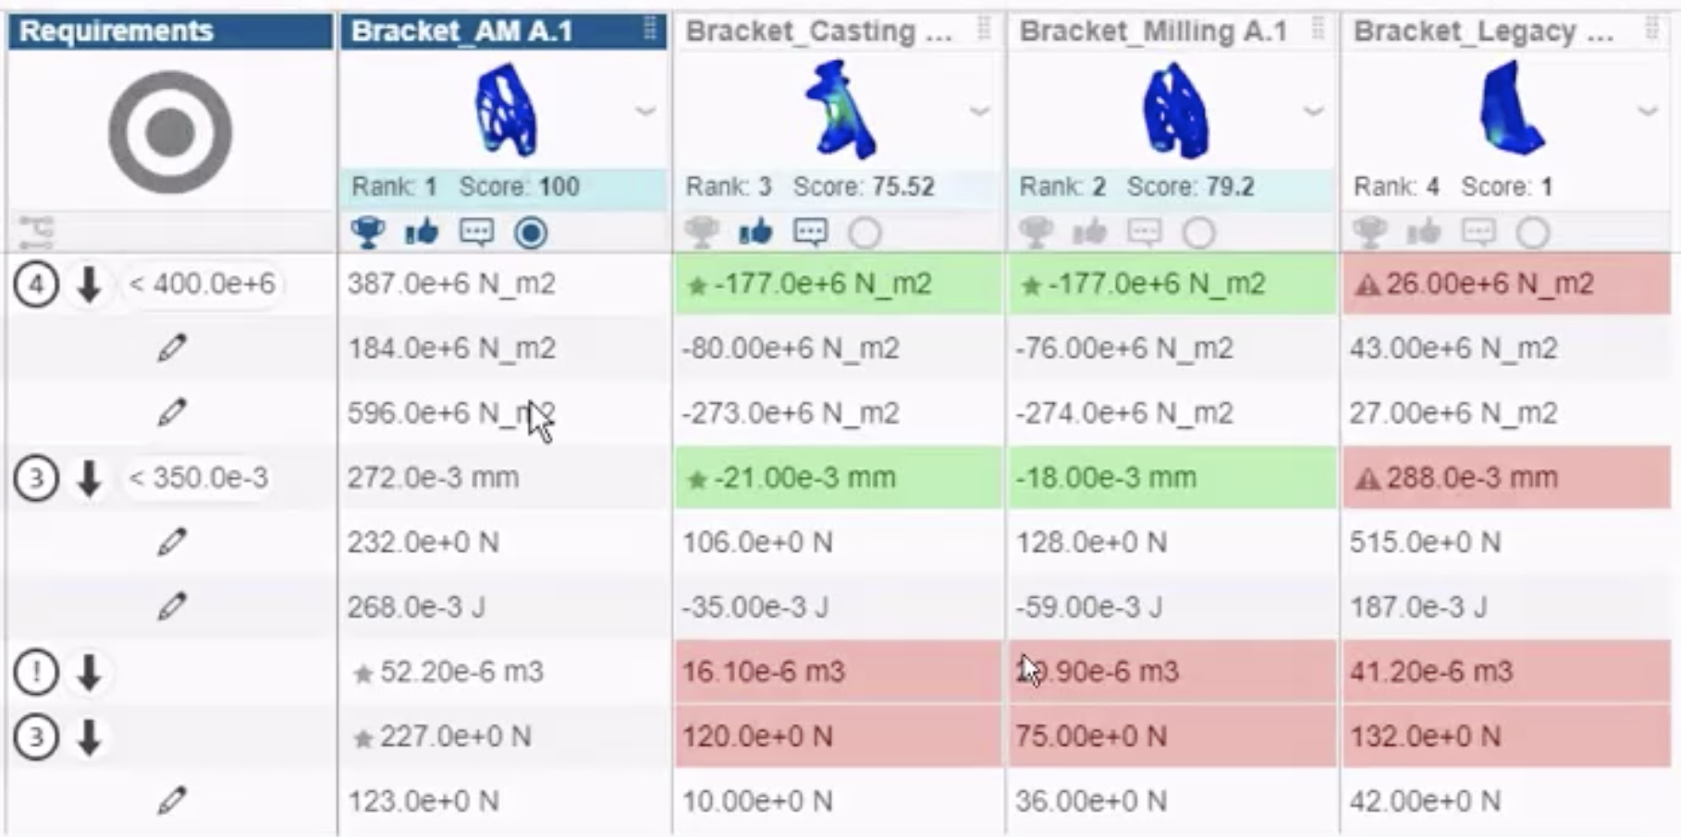
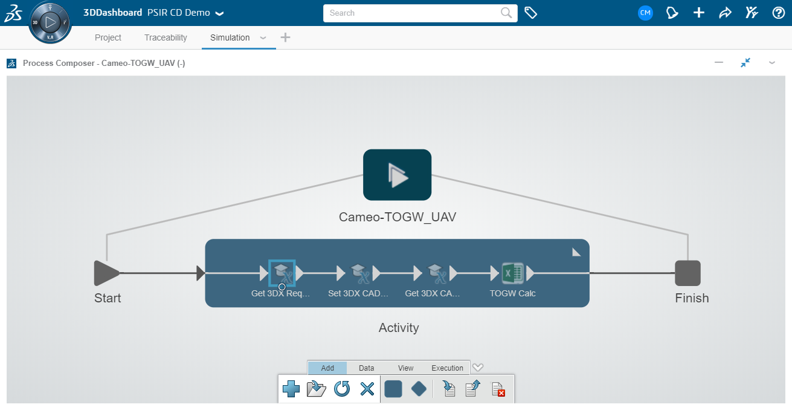
Future Plans
Model-based Product Line Engineering (MBPLE) based system model variants
Design models integrated multilevel trade studies and analysis using advance algorithms and results analytics using Dassault System 3DExperience platform Process Composer

